Slide 1
Hood Hockey Analysis
Sam Lawrence sl26@hood.edu,
Don Ngo dtn1@hood.edu,
Sarah Setiawan sss13@hood.edu,
Jeremias Argueta ja16@hood.edu
HoodHockey GitHub
CS473 Midterm Project Report
MARCH 20 2025

Slide 2
Description
Web application
Dataset: DRIVE and Instat
Visualizations
Analysis
Predictive analytics

Slide 3
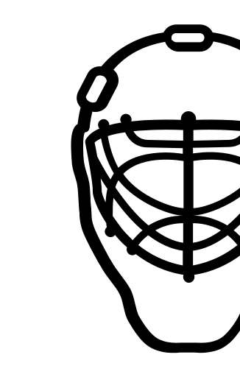




Objectives
1
Performance & Metrics Analysis
2
Intuitive Data Visualization
3
Customizable Reporting & Insights
4
.Real-time Data Ingestion & Storage

Slide 4
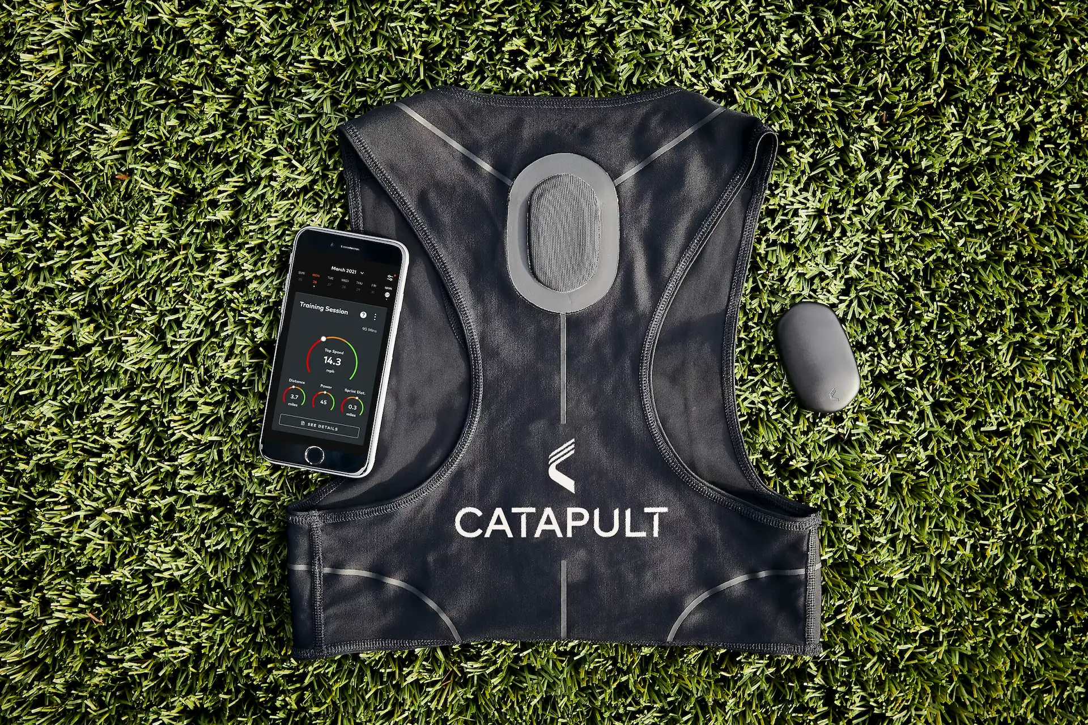
Background
Wearables
Player metrics: Drive
Game performance: Instat

Slide 5





Technical
Upload, Clean, Connect, Analyze, Visualize
Database: PostgreSQL
Backend: Django
Data Analysis: Python
Frontend: React.js

Slide 6

Current Status
Backend and Frontend connection
Upload files
Visualizations
Merging data

Slide 7
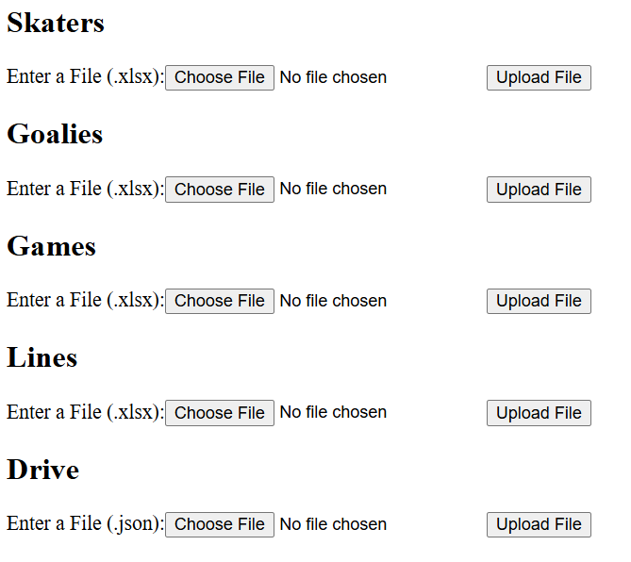
STATUS

Slide 8
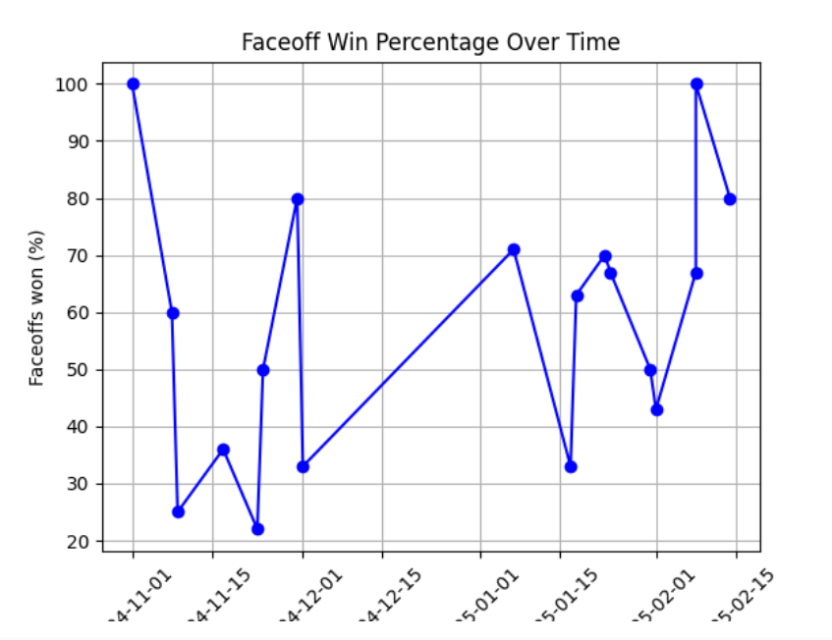
STATUS

Slide 9
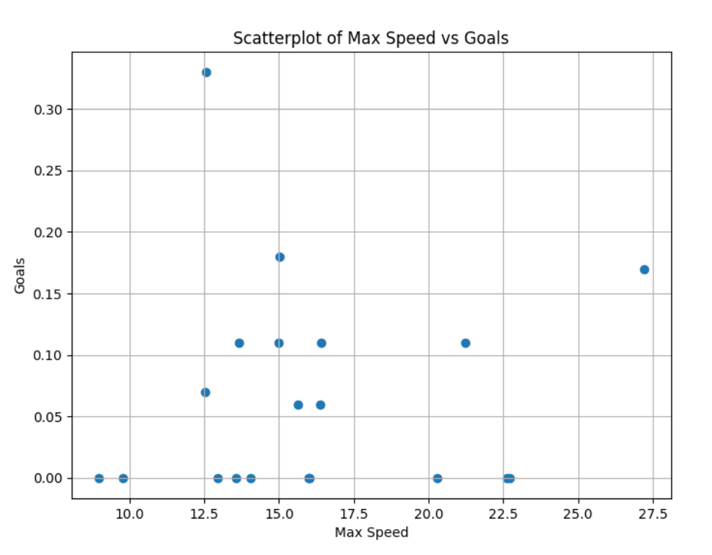
STATUS

Slide 10
Teamwork
Name | Tasks | Hours
Sam | Backend, front | ~80hrs
Don | Data cleaning, Analysis, Visualization, Webapp Development | ~40hrs
Sarah | Data cleaning, analyze data, documentation | ~30hrs
Jeremias | Data Cleaning, Shot analysis, Best Player | ~30hrs

Slide 11
Reflection
Task management
Watch games
Tech steck difficulties
Documentation

Slide 12
Next steps
Task | Process | Expected by
User Interface | Bootstrap & CSS Customizability | May
Analysis | Predictive & Current | Late April
Visualization | Player metrics & Performance progression | Late April

Slide 13
DEMO

